Slide 1
Link-State Routing Protocols
Routing Protocols and Concepts – Chapter 10

Slide 2
Objectives
Describe the basic features & concepts of link-state routing protocols.
List the benefits and requirements of link-state routing protocols.

Slide 3
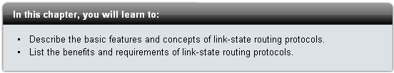
Introduction

Slide 4
Distance Vector vs. Link State
Distance vector routing protocols are like road signs because routers must make preferred path decisions based on a distance or metric to a network.
Just as travellers trust a road sign to accurately state the distance to the next town, a distance vector router trusts that another router is advertising the true distance to the destination network.
Link-state routing protocols take a different approach.
Link-state routing protocols are more like a road map because they create a topological map of the network and each router uses this map to determine the shortest path to each network.
Just as you refer to a map to find the route to another town, link-state routers use a map to determine the preferred path to reach another destination.

Slide 5
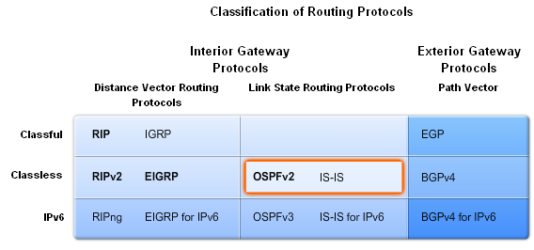
Link-State Routing
Link state routing protocols
  -Also known as shortest path first algorithms
-These protocols built around Dijkstra’s SPF

Slide 6
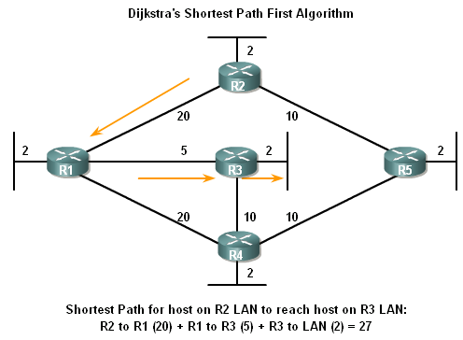
Link-State Routing
Dikjstra’s algorithm also known as the shortest path first (SPF) algorithm

Slide 7
Dijkstra’s Algorithm
Dijkstra's algorithm is commonly referred to as the shortest path first (SPF) algorithm.
This algorithm accumulates costs along each path, from source to destination.
Although, Dijkstra's algorithm is known as the shortest path first algorithm, this is in fact the purpose of every routing algorithm.
In the figure, each path is labelled with an arbitrary value for cost.
The cost of the shortest path for R2 to send packets to the LAN attached to R3 is 27.
Notice that this cost is not 27 for all routers to reach the LAN attached to R3.
Each router determines its own cost to each destination in the topology. In other words, each router calculates the SPF algorithm and determines the cost from its own perspective.

Slide 8
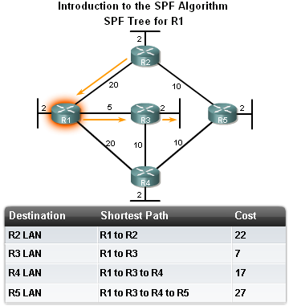
Link-State Routing
The shortest path to a destination is not necessarily the path with the least number of hops

Slide 9
Link-State Routing
Link-State Routing Process
How routers using Link State Routing Protocols reach convergence
    -Each routers learns about its own directly connected networks
    -Link state routers exchange hello packet to “meet” other directly
    connected link state routers.
    -Each router builds its own Link State Packet (LSP) which includes information about neighbors such as neighbor ID, link type, & bandwidth.
    -After the LSP is created the router floods it to all neighbors who then store the information and then forward it until all routers have the same information.
    -Once all the routers have received all the LSPs, the routers then construct a topological map of the network which is used to determine the best routes to a destination

Slide 10
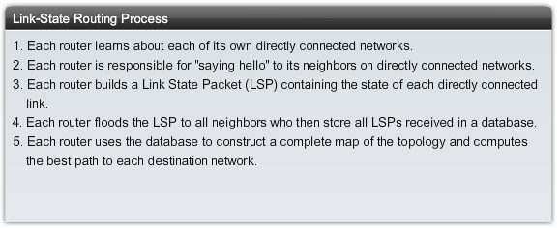
Link State Routing Process

Slide 11
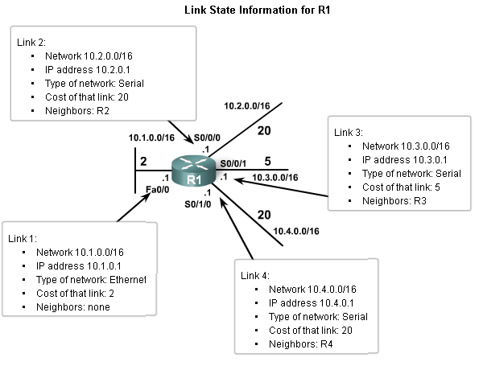
Link-State Routing
Directly Connected Networks
Link
This is an interface on a router
Link state
This is the information about the state of the links

Slide 12
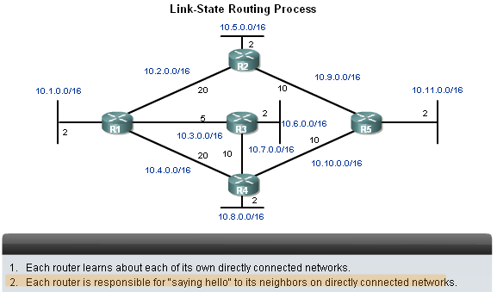
Link-State Routing
Sending Hello Packets to Neighbors
Link state routing protocols use a hello protocol
Purpose of a hello protocol:
-To discover neighbors (that use the same link state routing protocol) on its link

Slide 13
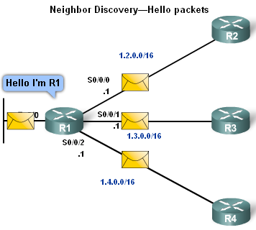
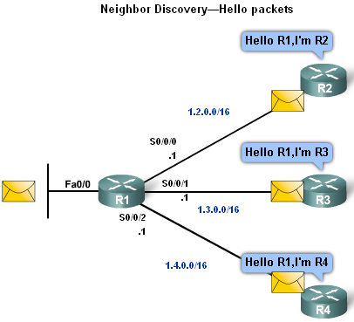
Link-State Routing
Sending Hello Packets to Neighbors
Connected interfaces that are using the same link state routing protocols will exchange hello packets.
Once routers learn it has neighbors they form an adjacency
-2 adjacent neighbors will exchange hello packets
-These packets will serve as a keep alive function

Slide 14

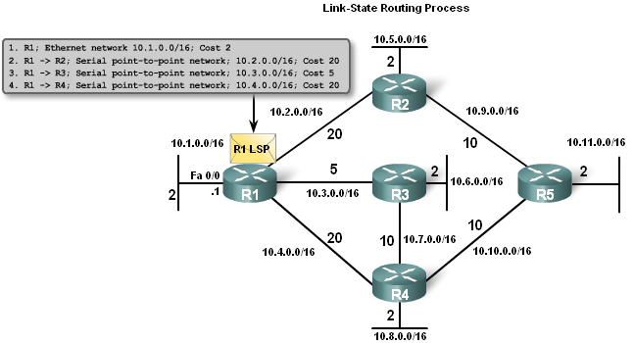
Link-State Routing
Building the Link State Packet
Each router builds its own Link State Packet (LSP)
Contents of LSP:
-State of each directly connected link
-Includes information about neighbors such as neighbor ID, link type, & bandwidth.

Slide 15
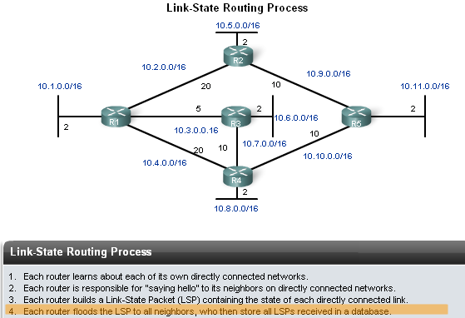
Link-State Routing
Flooding LSPs to Neighbors
Once LSP are created they are forwarded out to neighbors.
  -After receiving the LSP the neighbor continues to forward it throughout routing area.

Slide 16
Link-State Routing
LSPs are sent out under the following conditions
-Initial router start up or routing process
-When there is a change in topology
In addition to the link-state information, other information is included in the LSP - such as sequence numbers and aging information - to help manage the flooding process.
This information is used by each router to determine if it has already received the LSP from another router or if the LSP has newer information than what is already contained in the link-state database.
This process allows a router to keep only the most current information in its link-state database.

Slide 17
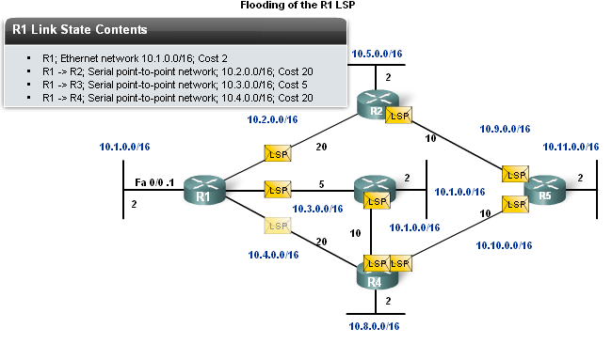
LSP Flooding

Slide 18
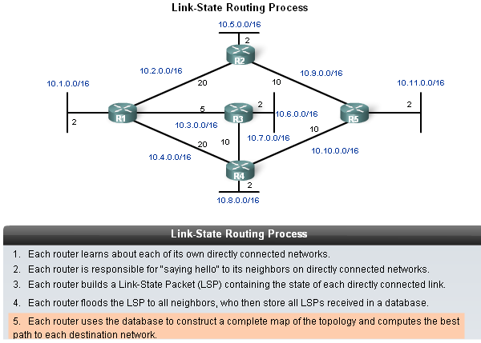
Link-State Routing
Constructing a link state data base
Routers use a database to construct a topology map of the network

Slide 19
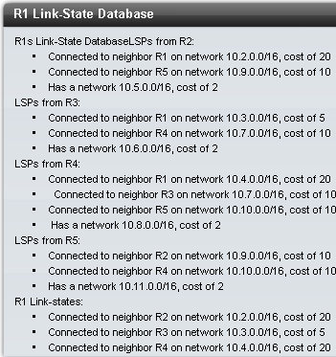
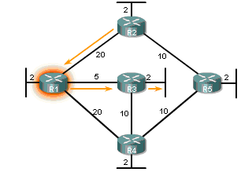
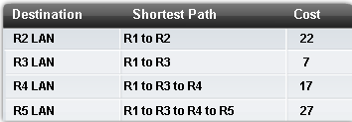
Link-State Routing

Slide 20
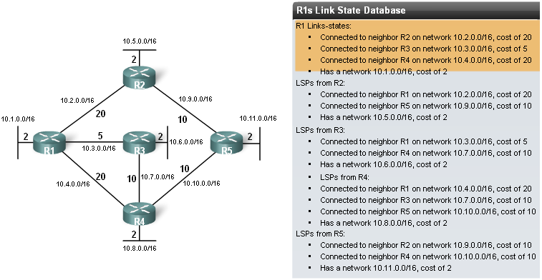
Link-State Routing
Shortest Path First (SPF) Tree
Building a portion of the SPF tree
Process begins by examining R2’s LSP information
-R1 ignores 1st LSP
Reason: R1 already knows it’s connected to R2

Slide 21
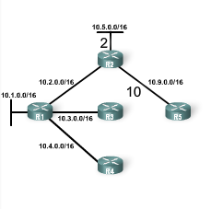

Link-State Routing
Building a portion of the SPF tree
-R1 uses 2nd LSP
Reason: R1 can create a link from R2 to R5. This information is added to R1’s SPF tree

Slide 22
Link-State Routing
Building a portion of the SPF tree
-R1 uses 3rd LSP
      Reason: R1 learns that R2 is connected to 10.5.0.0/16.
      This link is added to R1’s SPF tree.

Slide 23
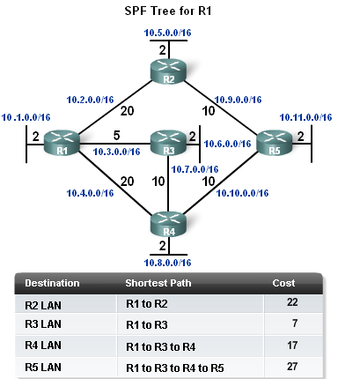
Link-State Routing
Determining the shortest path
  The shortest path to a destination determined by adding the costs & finding the lowest cost

Slide 24
SPF Tree Example
The figure shows the SPF tree for R1. Using this tree, the SPF algorithm results indicate the shortest path to each network.
Only the LANs are shown in the table, but SPF can also be used to determine the shortest path to each WAN link network.
In this case, R1 determines that the shortest path for each network is:
Network 10.5.0.0/16 via R2 serial 0/0/0 at a cost of 22
Network 10.6.0.0/16 via R3 serial 0/0/1 at a cost of 7
Network 10.7.0.0/16 via R3 serial 0/0/1 at a cost of 15
Network 10.8.0.0/16 via R3 serial 0/0/1 at a cost of 17
Network 10.9.0.0/16 via R2 serial 0/0/0 at a cost of 30
Network 10.10.0.0/16 via R3 serial 0/0/1 at a cost of 25
Network 10.11.0.0/16 via R3 serial 0/0/1 at a cost of 27

Slide 25
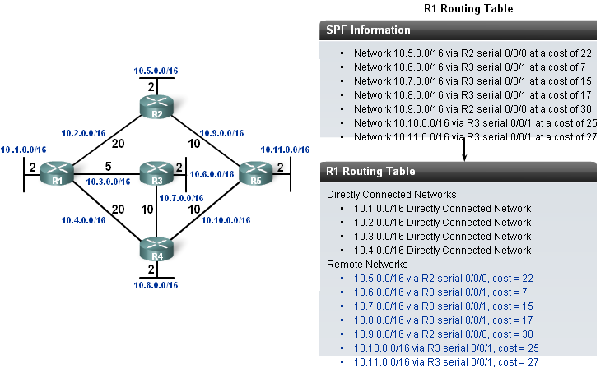
Link-State Routing
Once the SPF algorithm has determined the shortest path routes, these routes are placed in the routing table.

Slide 26
Link-State Routing Protocols
Advantages of a Link-State Routing Protocol
Routing protocol | Builds Topological map | Router can independently determine the shortest path to every network. | Convergence | A periodic/ event driven routing updates | Use of LSP
Distance vector | No | No | Slow | Generally No | No
Link State | Yes | Yes | Fast | Generally Yes | Yes

Slide 27
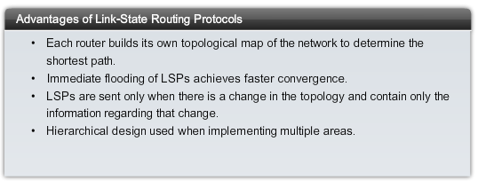
Advantages

Slide 28
Link-State Routing Protocols
Requirements for using a link state routing protocol
Memory requirements
Typically link state routing protocols use more memory
Processing Requirements
More CPU processing is required of link state routing protocols
Bandwidth Requirements
Initial startup of link state routing protocols can consume lots of bandwidth

Slide 29
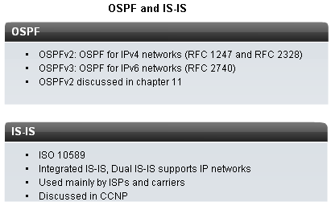
Link-State Routing Protocols
2 link state routing protocols used for routing IP
-Open Shortest Path First (OSPF)
-Intermediate System-Intermediate System (IS-IS)

Slide 30
Summary
Link State Routing protocols are also known as Shortest Path First protocols
Summarizing the link state process
-Routers 1ST learn of directly connected networks
-Routers then say “hello” to neighbors
-Routers then build link state packets
-Routers then flood LSPs to all neighbors
-Routers use LSP database to build a network topology map & calculate the best path to each destination

Slide 31
Summary
Link
An interface on the router
Link State
Information about an interface such as
-IP address
-Subnet mask
-Type of network
-Cost associated with link
-Neighboring routers on the link

Slide 32
Summary
Link State Packets
After initial flooding, additional LSP are sent out when a change in topology occurs
Examples of link state routing protocols
-Open shortest path first
-IS-IS

